Slide 1
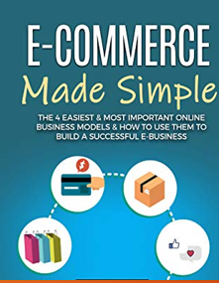


Trading System
Coordinator Name: Mr. Fahad Maqbool
Supervised By: Madam Samreen Razzaq
Talha Nadeem Bcsf16m047
talhanadeemsgd@gmail.com 03057472707

Slide 2
Introduction Project Area:
Trading System is Ecommerce Site, used as an Buying & Selling Platform From Where Customer can Buy & Sell, & The Main Feature of This Project is, It is the , Where The Machine Learn From the Customer Response & Response According to it, The ITS provides Platform Where User can Create Account & See What ever they Want ,The Technology Behind Them is Asp.net & PHP-MYSQL & WordPress Also, ITS is very helpful for Customer Who Living Away from City & Need Something Than They Just Order it & We Will Send it To Their Doorstep.

Slide 3
Current System and Lackness:
Traditional Business of Pakistan Only Sell by:
Locally
Bounded Time Location & Product
High Cost Because Of Property Area
Man Power
Accommodation
Security
Electricity
More Time & Man Power Required

Slide 4

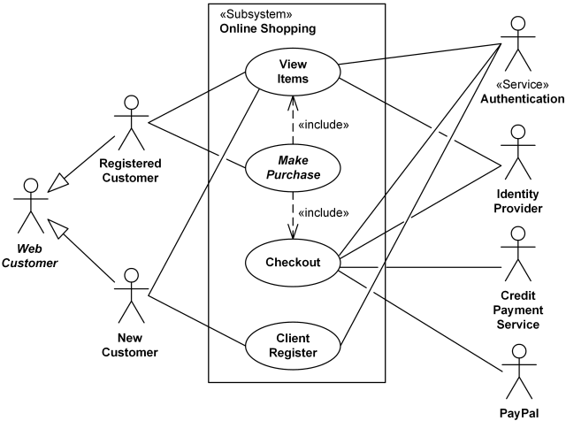

Use case Diagram

Slide 5
Grant Chart

Slide 6
ER Diagram

Slide 7
Sequence Diagram

Slide 8
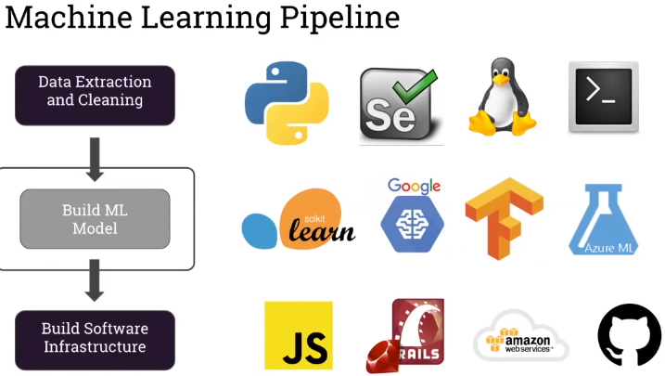
Tools & Languages Require to Build Recommendation System
Tools
Xampp
Photoshop
Languages
Asp.net , C#
PHP-My Sql

Slide 9
Problem Statement:
The Problem Which is Solve by it is That Traditional Shops Cause
High Expensive (Property, Electricity, Materials, Employer & Other Expense
Not Easily Grow & Scaleable
Every Type of Person Either Customer Or Business Man Need E commerce to Buy & Sell...
Amazon Ali Baba Flipkart are Not Available in Pakistan..&
OLX Have Security Automation, Escrow Account & Geographical Location Issues....
So, To Shift Local Shops to E commerce is Solves this Issue..

Slide 10
Scope of Project:
Future Work ( Excluded)
Product Customization Feature
Snap That (Image Processing )
Sell Services Like Supertasker
Android App
NLP (to Check Review Polarity)
AI Shopping Chatbot
Daraz Wallet
Sell Service Like Supertasker
SEO of Website
International Shipment
Rental Bases (Closet) Business Model
2nd Hand Products (olx/Affordable.pk) BM

Slide 11
Applications of Project:
Business Purpose
Online Store Like Daraz
Web Development Expertise
Trading Purpose (Buying Selling Purpose)

Slide 12
Potential Advantages to Customers:
3A(Anyone Anytime Anywhere) Buying With Cheaper & Faster Than Traditional..
No Time Area Or Person Bounded (Anyone Anytime Anywhere)
Better Faster Cheaper & Convientent
Min Cost Because No Physical Shop Required, Not Employ & No Other Expense..
Max Sale Because High Reach Of Customer (World Wide Buy)
Passive Income for Long Term
More Secure Because Everything Transparent
More Option Because Any Product From World Wide Can Buy
No Sales Tax

Slide 13
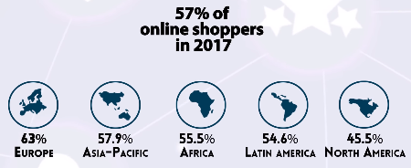
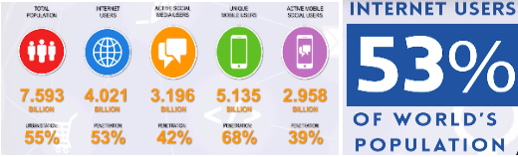
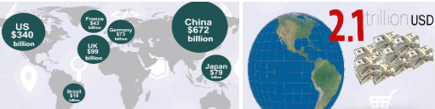
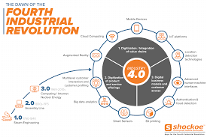
Profit in Business
Allows you to sell products 365 days a year, 24 hours a day.
Lowers your costs and raises your sales margins
Creates cost-saving efficiencies
Creates an automated cycle of repeat business
Connects you to new customers previously unavailable to you due to distance and operating hours
Collects customer data, demographics, and produces marketing leads
Gives your customers control over how and when they’d like to shop

Slide 14


Product purchase (online order)
A user can easily purchase a current customized laptop by placing an online order. The interface is very effective and easy to make the order successful.
This process involves to deliver the product to our user at home* (TCS).
He can also collect his customized product from our trusted store.
Cash on delivery*.
Payment methods involves the ATM transections.

Slide 15
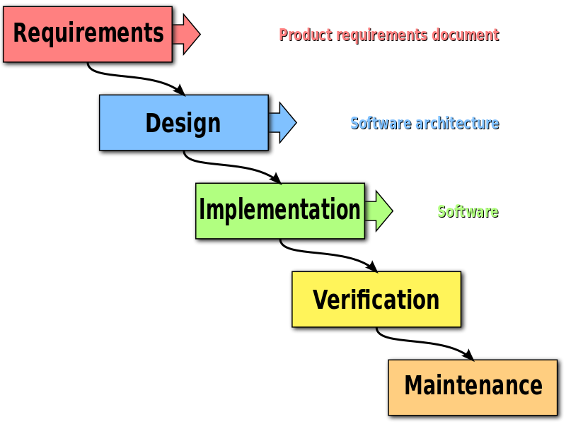
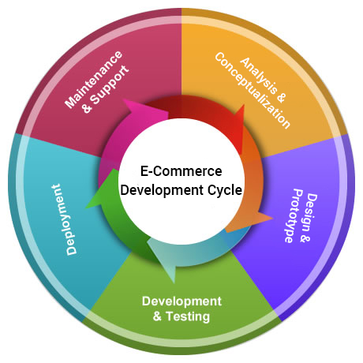
Implementation Plan & Process Methadology:
Steps To Build Ecommerce Platform
Build Ecommerce Site Or Outsource it From Web Developer
Or Use the Third Party Platform..
Create Web Builder Site Like

Slide 16
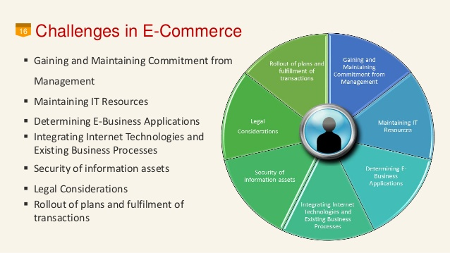
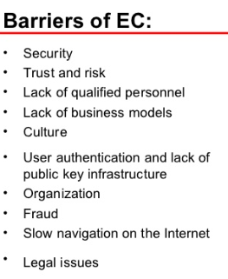
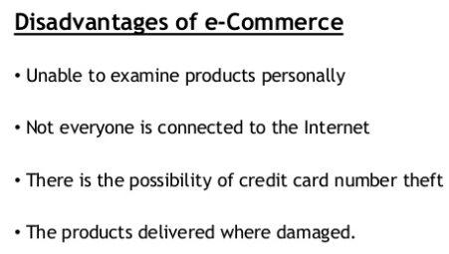
Chanalenges in Ecommerce's
Finding the right products to sell. ...& Finding Right & Best Sellers & Buyers for their Business
Competition Like Daraz
PayPal Absence....
Security Threats & Cyber Security. ...
Create Customer Trust from real to Virtual Store Because People Do not Trust Paperless & Virtual Transaction....
Achieving profitable long-term growth.

Slide 17
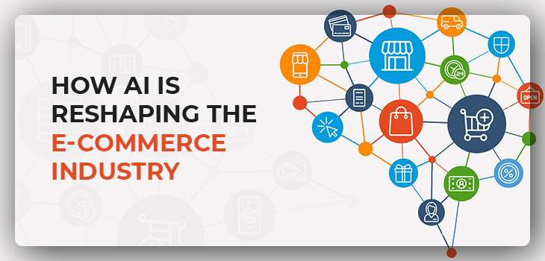

Slide 18
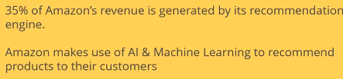
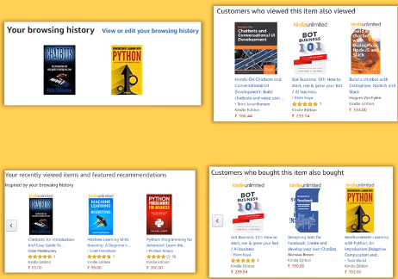
Intelligent Trading System
Why AI With E commerce?
World Most of the Jobs are Replaced By AI & ML, And That Increase the Demand of AI Experts in the Market Place,
Every Domain / Field Either it is Technical /Financial / Health Care /Auto Sector/ Industrial & All Other Need AI Experts
So, AI Alone is a Great Thing…
Example
Amazon Recommendation
YouTube Recommendation
Google Recommendation
Facebook Recommendation

Slide 19
Customization Current user suggestions
At the time of customization a user can see the expert suggestions.
These suggestions will help him/her to easily select and decide that which part is best for the product.
If a part for example a CPU is not best fit to customized laptop, system will suggest that change the CPU model/frequency/core to the better one.
Customization means a user can select a company and model of a laptop and can select its parts/accessories according to his necessity. That provides him a relief and easiness.
Example: Make Your Own Bundle jazz (*303#)
Why: Easy to buy a desirable laptop.
This involves the users most searched or visited companies or products.
Our system save and analyze those searches and make those searches to his interests and make the user up to date.
System will send him/her notification mails of items or products that recently launched or being launched.

Slide 20
References
https://core.ac.uk/download/pdf/38090117.pdf
https://en.wikipedia.org/wiki/E-commerce
https://cyber.harvard.edu/olds/ecommerce/library.html
Standard Benchmarks
.

Slide 21
Implementation Work

Slide 22



